Slide 1
Need of programming Languages
Computers can execute tasks very rapidly. They can handle a greater amount of input data than you can. But they can not design a strategy to solve problems for you.
Need one programming language to communicate with computer to solve the problem.

Slide 2
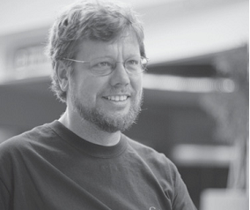
Python – Why?
Python has a simple syntax. Python programs are clear and easy to read. At the same time, Python provides powerful programming features, and is widely used.
Companies and organizations that use Python include YouTube, Google, Yahoo, and NASA. Python is well supported and freely available at www.python.org.
Guido van Rossum is the creator of the Python programming language, first released in the early 1990s. Its name comes from a 1970s British comedy sketch television show called Monty Python’s Flying Circus.

Slide 3
Python….
Python is an example of a high-level language; other high-level languages you might have heard of are C, C++, Perl, and Java.
There are also low-level languages, sometimes referred to as “machine languages” or “assembly languages.”
Computers can only run programs written in low-level languages. So programs written in a high-level language have to be processed before they can run. This extra processing takes some time, which is a small disadvantage of high-level languages.

Slide 4

Python….
Two kinds of program translator to convert from high-level languages into low-level languages: interpreters and compilers.
An interpreter processes the program a little at a time, alternately reading lines and performing computations.

Slide 5
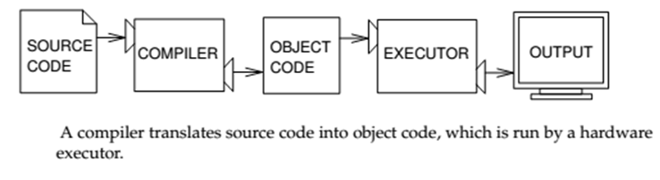
Python….
A compiler reads the program and translates it completely before the program starts running. In this context, the high-level program is called the source code, and the translated program is called the object code or the executable. Once a program is compiled, you can execute it repeatedly without further translation.

Slide 6
Python….
Python is considered an interpreted language because Python programs are executed by an interpreter. There are two ways to use the interpreter:
interactive mode and script mode.

Slide 7
Python….Interactive mode
In interactive mode, you type Python programs and the interpreter displays the result:
>>> 1 + 1 2
The shell prompt, >>>, is the prompt the interpreter uses to indicate that it is ready. If you type 1 + 1, the interpreter replies 2.

Slide 8
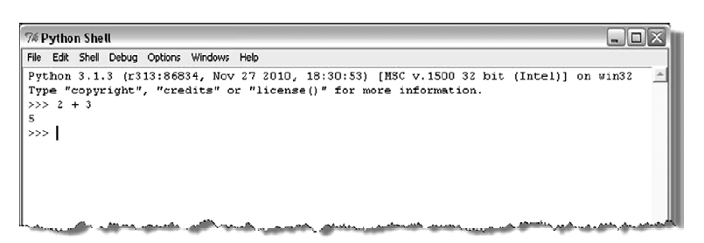
Python …. Shell

Slide 9
Python…. Script Mode
Alternatively, you can store code in a file and use the interpreter to execute the contents of the file, which is called a script.
By convention, Python scripts have names that end with .py.
Working in interactive mode is convenient for testing small pieces of code because you can type and execute them immediately.
But for anything more than a few lines, you should save your code as a script so you can modify and execute it in the future.

Slide 10
Python….Script Mode …
File name : first.py
print(4+3) print(4-3) print(4>3) print("hello World")

Slide 11
Problem that can be solved by Sequential Algorithms
Some of the problem involves simple computation of values

Slide 12
Example Problem
Little Bob loves chocolate, and he goes to a store with Rs. N in his pocket. The price of each chocolate is Rs. C. The store offers a discount: for every M wrappers he gives to the store, he gets one chocolate for free. This offer shall be availed only once. How many chocolates does Bob get to eat?

Slide 13
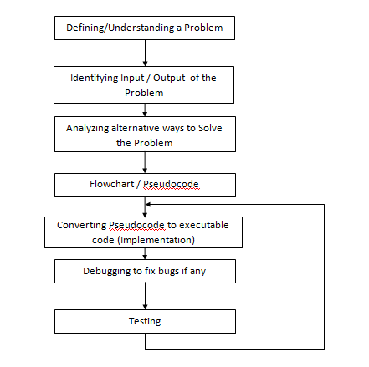

Slide 14
PAC
Input | Processing | Output | Solution Alternatives
Money_In_Hand, Cost_Of_Chocolate, Wrapper_Offer | Number_Of_Chocolate = Chocolate got by money + Chocolate got by returning wrapper | Number_Of_Chocolate

Slide 15
Pseudocode
READ Money_In_Hand and Cost_Of_Chocolate
COMPUTE Number_Of_choc as Money_In_Hand /Cost_Of_Chocolate
Number_Of_choc = Number_Of_choc + (Number_Of_choc /Wrapper_Offer)
PRINT num_of_chocolates

Slide 16
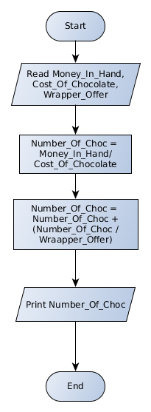

Slide 17
Concepts of Python for Solving Sequential Problems

Slide 18
What is an Identifier?
An identifier is a sequence of one or more characters used to name a given program element. In Python, an identifier may contain letters and digits, but cannot begin with a digit. The special underscore character can also be used.

Slide 19
Rules for Identifier
An identifier is a sequence of one or more characters used to provide a name for a given program element.
Example : line, salary, emp1, emp_salary
Python is case sensitive, thus, Line is different from line.
Identifiers may contain letters and digits, but cannot begin with a digit.
The underscore character, _, is also allowed to aid in the readability of long identifier names. It should not be used as the first character
Spaces are not allowed as part of an identifier.

Slide 20
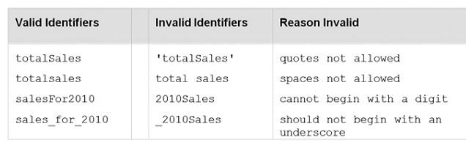
Identifier Naming

Slide 21

Keywords
A keyword is an identifier that has pre-defined meaning in a programming language.
Therefore, keywords cannot be used as “regular” identifiers. Doing so will result in a syntax error, as demonstrated in the attempted assignment to keyword and below,

Slide 22
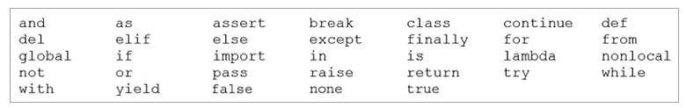
Keywords in Python

Slide 23

Variables and Identifiers
A variable is a name (identifier) that is associated with a value.
A simple description of a variable is “a name that is assigned to a value,”
Variables are assigned values by use of the assignment operator, num = 10
num = num + 1

Slide 24
Comments
Meant as documentation for anyone reading the code
Single-line comments begin with the hash character ("#") and are terminated by the end of line.
Python ignores all text that comes after # to end of line
Comments spanning more than one line are achieved by inserting a multi-line string (with """ as the delimiter one each end) that is not used in assignment or otherwise evaluated, but sits in between other statements.
#This is also a comment in Python
""" This is an example of a multiline comment that spans multiple lines ... "“”

Slide 25
Literals
A literal is a sequence of one or more characters that stands for itself.

Slide 26
Numeric literal
A numeric literal is a literal containing only the digits 0–9, an optional sign character (1 or 2), and a possible decimal point. (The letter e is also used in exponential notation).
If a numeric literal contains a decimal point, then it denotes a floating-point value, or “float” (e.g., 10.24); otherwise, it denotes an integer value (e.g., 10).
Commas are never used in numeric literals

Slide 27
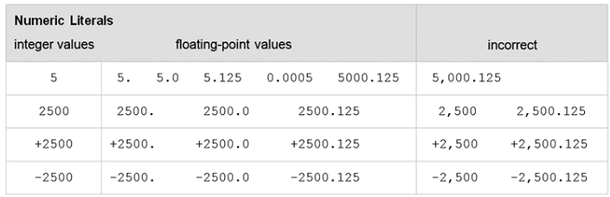
Numeric Literals in Python
Since numeric literals without a provided sign character denote positive values, an explicit positive sign character is rarely used.

Slide 28
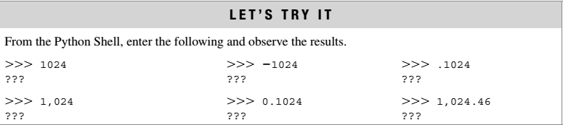

Slide 29
String Literals
String literals, or “strings,” represent a sequence of characters, 'Hello' 'Smith, John' "Baltimore, Maryland 21210“
In Python, string literals may be delimited (surrounded) by a matching pair of either single (') or double (") quotes.
>>> print('Welcome to Python!') >>>Welcome to Python!

Slide 30
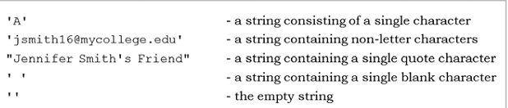
String Literal Values

Slide 31
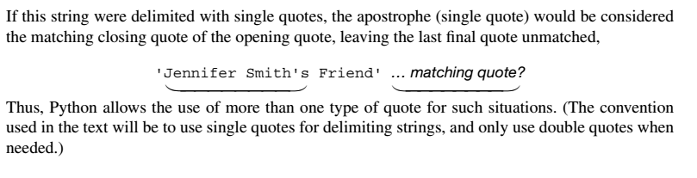
Note

Slide 32
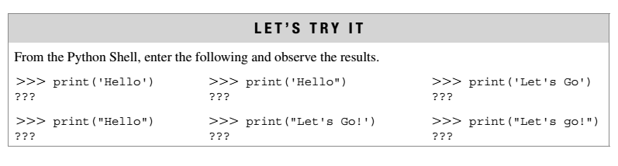

Slide 33
Control Characters
Special characters that are not displayed on the screen.
Control the display of output
Control characters do not have a corresponding keyboard character and represented by a combination of characters called an escape sequence.
The backslash (\) serves as the escape character in Python.
For example, the escape sequence '\n', represents the newline control character, used to begin a new screen line.

Slide 34
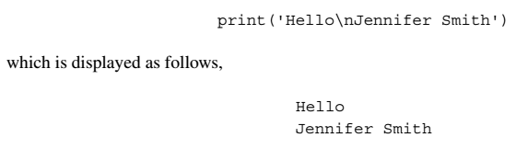

Slide 35
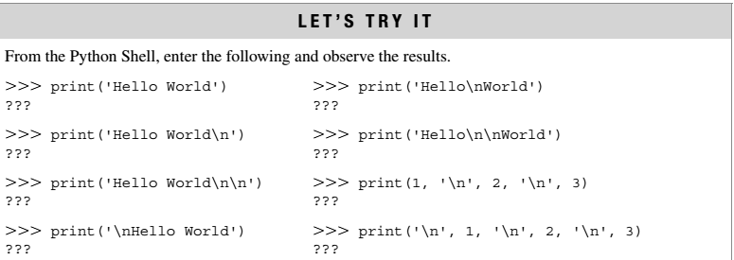

Slide 36
Data Types
Python's data types are built in the core of the language
They are easy to use and straightforward.
Data types supported by Python
Boolean values
None
Numbers
Strings
Tuples
Lists
Sets

Slide 37
Boolean values
Primitive datatype having one of two values: True or False
some common values that are considered to be True or False

Slide 38
Boolean values
print bool(True) | True
print bool(False) | False
print bool("text") | True
print bool("") | False
print bool(' ') | True
print bool(0) | False
print bool() | False
print bool(3) | True
print bool(None) | False

Slide 39
None
Special data type - None
Basically, the data type means non existent, not known or empty
Can be used to check for emptiness

Slide 40
Numbers
Types of numbers supported by Python:
Integers
floating point numbers
complex numbers
Fractional numbers

Slide 41
Integers
Integers have no fractional part in the number
Integer type automatically provides extra precision for large numbers like this when needed (different in Python 2.X)
>>> a = 10
>>> b = a

Slide 42
Binary, Octal and Hex Literals
>>> 0b1, 0b10000, 0b11111111 # Binary literals: base 2, digits 0-1
0o1, 0o20, 0o377
# Octal literals: base 8, digits 0-7
>>> 0x01, 0x10, 0xFF # Hex literals: base 16, digits 0-9/A-F
(1, 16, 255)

Slide 43
Conversion between different bases
Provides built-in functions that allow you to convert integers to other bases’ digit strings
>>> oct(64), hex(64), bin(64)
# Numbers=>digit strings
('0o100', '0x40', '0b1000000')
These literals can produce arbitrarily long integers

Slide 44
Numbers can be very long
>>> X = 0xFFFFFFFFFFFFFFFFFFFFFFFFFFFF
>>> X 5192296858534827628530496329220095
>>> oct(X) '0o17777777777777777777777777777777777777‘
>>> bin(X) '0b111111111111111111111111111111111111111111111111111111111 ...and so on... 11111‘

Slide 45
Floating Point Numbers
Number with fractional part
>>> 3.1415 * 2
>>>6.283

Slide 46
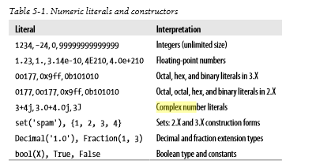
Floating Point Numbers

Slide 47
Arithmetic overflow
a condition that occurs when a calculated result is too large in magnitude (size) to be represented, >>>1.5e200 * 2.0e210 >>> inf This results in the special value inf (“infinity”) rather than the arithmetically correct result 3.0e410, indicating that arithmetic overflow has occurred.

Slide 48
Arithmetic underflow
a condition that occurs when a calculated result is too small in magnitude to be represented, >>>1.0e-300 / 1.0e100 >>>0.0
This results in 0.0 rather than the arithmetically correct result 1.0e-400, indicating that arithmetic underflow has occurred.

Slide 49
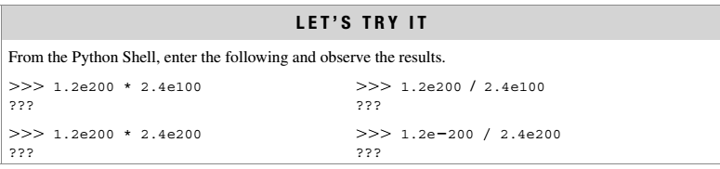
Arithmetic overflow occurs when a calculated result is too large in magnitude to be represented. Arithmetic underflow occurs when a calculated result is too small in magnitude to be represented

Slide 50
Input and output function
Input function : input
Basic_pay = input('Enter the Basic Pay: ')
Output function : print
>>> print('Hello world!')
print(‘Net Salary', salary)

Slide 51
Input and output function
Input function : input
Basic_pay = input('Enter the Basic Pay: ')
Input received is always a string.
To convert it to integer use int function of Python
Basic_pay = int(input('Enter the Basic Pay: '))
Output function : print
>>> print('Hello world!')
print(‘Net Salary', salary)

Slide 52
Repeated Print
>>>print(‘a’*15)
# prints ‘a’ fifteen times
>>>print(‘\n’*15)
# prints new line character fifteen times

Slide 53
Complex Numbers
A complex number consists of an ordered pair of real floating point numbers denoted by a + bj, where a is the real part and b is the imaginary part of the complex number.
complex(x) to convert x to a complex number with real part x and imaginary part zero
complex(x, y) to convert x and y to a complex number with real part x and imaginary part y. x and y are numeric expressions

Slide 54
Complex Numbers
>>> 1j * 1J
(-1+0j)
>>> 2 + 1j * 3
(2+3j)
>>> (2 + 1j) * 3
(6+3j)
A = 1+2j; B=3+2j
# Mutpile statements can be given in same line using semicolon
C = A+B; print(C)

Slide 55
Complex Numbers
# prints real part of the number
print(A.real)
# prints imaginary part of the number
print(A.imag)
# Can do operations with part of complex number
print(A.imag+3)

Slide 56
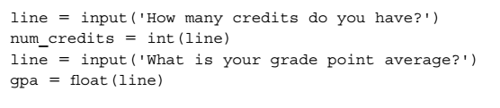
Type conversion…
Here, the entered number of credits, say '24', is converted to the equivalent integer value, 24, before being assigned to variable num_credits. For input of the gpa, the entered value, say '3.2', is converted to the equivalent floating-point value, 3.2. Note that the program lines above could be combined as follows,

Slide 57
Assignment Statement
Statement | Type
spam = 'Spam' | Basic form
spam, ham = 'yum', 'YUM' | Tuple assignment (positional)
[spam, ham] = ['yum', 'YUM'] | List assignment (positional)
a, b, c, d = 'spam' | Sequence assignment, generalized
a, *b = 'spam' | Extended sequence unpacking (Python 3.X)
spam = ham = 'lunch' | Multiple-target assignment
spams += 42 | Augmented assignment (equivalent to spams = spams + 42)

Slide 58
Range
>>>a,b,c = range(1,4)
>>>a
1
>>>b
2
>>> S = "spam" >>> S += "SPAM" # Implied concatenation
>>> S
'spamSPAM'

Slide 59
Assignment is more powerful in Python
>>> nudge = 1
>>> wink = 2
>>> nudge, wink = wink, nudge
# Tuples: swaps values
# Like T = nudge; nudge = wink; wink = T
>>> nudge, wink
(2, 1)

